Slide 1
Fighter Plane
Rifat Ara Ahmed – 011 143 119
Akib Bhuia – 011 143 120

Slide 2
Introduction
This is a Obstacle avoidance 2D game where you have to move the object to avoid the collision and keep going to get best score possible. The object is a Fighter Plane and we have to avoid bombs using arrow keys. It increases the game speed when score increase. When any collision occurs, it stops the game and shows high score.

Slide 3
Tasks
Rifat Ara Ahmed
Applying texturing
Control events.
Akib Bhuia
Collision handle
Rendering.

Slide 4
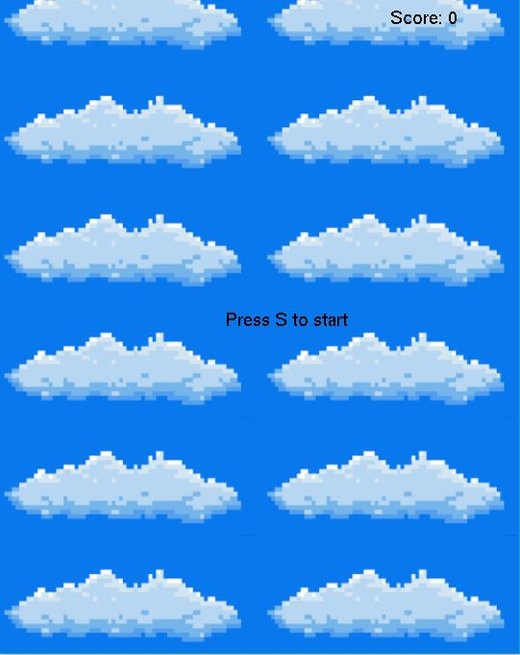
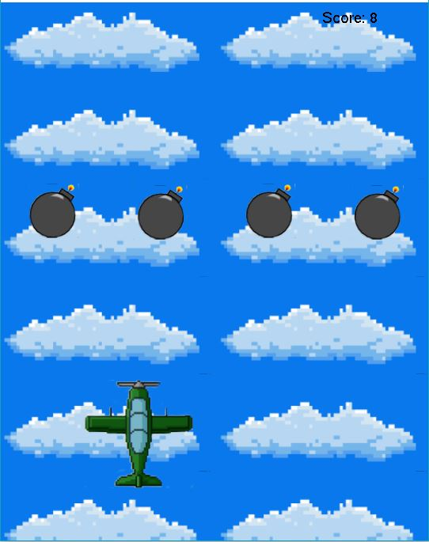
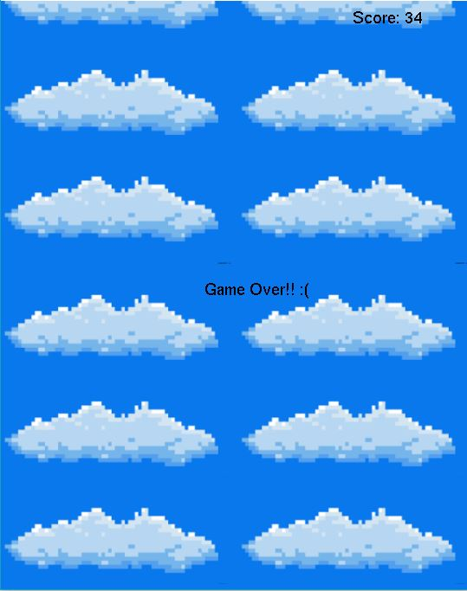
Game Screenshots

Slide 5
Thank You

